Slide 1
School Program

Slide 2


A highly interactive Learning and Development Center that provides children aged 2-16 with a safe, unique, and realistic educational environment to do what comes naturally to them; role-play.
From police officer to dentist to journalist, KidZania offers over 60 role-playing activities in more than 40 establishments, enabling children to understand the world of grown-ups better by being grown-ups themselves.
KidZania’s attention to professionalism and training has earned it the highest level of trust among parents, educators and community leaders as a facility where kids can have fun, exert their independence, and be safe.
2

Slide 3


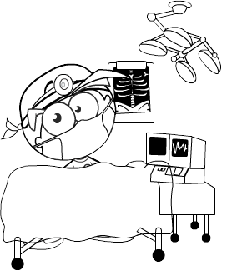











KidZania Essence in Learning and Development
  CHILDREN FOCUSED
  BASED ON ROLE-PLAY
  REALITY-BASED
  INTERACTIVE
  FUN
  SKILL-DEVELOPER
  VALUE-PROMOTER
  SAFE
  THRILLING
  EDUCATIONAL
  DETAIL-ORIENTED
  CURRENT
  ACCESSIBLE FOR ALL
  SUSTAINABLE

Slide 4


Activities
Establishments | KidZos | Activity Breakdown
Acting Academy |  | Street Shows, Dance shows or starring in a Play
Animation Studio |  | Stop motion video creation
Aviation Academy |  | Cabin Crew
Courier Service |  | Delivering and collecting packages
Crime Scene Investigation |  | Investigating a crime case
Dental Clinic |  | Patient oral care
Fashion Studio |  | Putting on a fashion show
Government Services Office |  | Window washing or customer happiness surveys
Hospital |  | Emergency paramedics and neonatal nursery
10
10
8
5
10
10
10
8
8
*kidZos salary and fee may change without prior notice
4
4

Slide 5
Activities
Establishments | KidZos | Activity Breakdown
Hotel |  | Housekeeping
Innovation Lab |  | Assembling, coding and testing a robot
Police Station |  | Emergency response and solving cases
Radio Station |  | Roaming reporters
Recycling Centre |  | Charitable and garment donations
Supermarket |  | Supermarket employee and cashier
Vault |  | Secure delivery and collection of money movement
8
10
8
8
2
8
8
*kidZos salary and fee may change without prior notice
5
5

Slide 6

Activities
Establishments | KidZos | Activity Breakdown
Astronaut Training Centre |  | Life in space exhibition
Aviation Academy |  | Pilot training
Milk Factory |  | Milk manufacturing
Styling Salon |  | Nail design barber services, make up and hair styling
Juice Factory |  | Juice manufacturing
Climbing Building |  | Climbing technique training (height restrictions apply)
Fire Station |  | Training to be a firefighter
Stadium |  | Football athlete training
Steel Structure |  | High ropes course (height restrictions apply)
University |  | Learning about engineering through experiments
10
12
10
10
12
12
10
10
10
10
*kidZos salary and fee may change without prior notice
6
6

Slide 7
Toddler Activities
Establishments | Activity Breakdown
Construction Site | Building blocks activity
Vita’s Diner | Kitchen play
Chika’s Spotlight | Open stage, discos and puppet shows
Bache’s Play Den | Soft pay area
Driving Circuit | Peddle car driving
Science Lab | Water play area
Supermarket | Being a customer
*kidZos salary and fee may change without prior notice
7
7

Slide 8
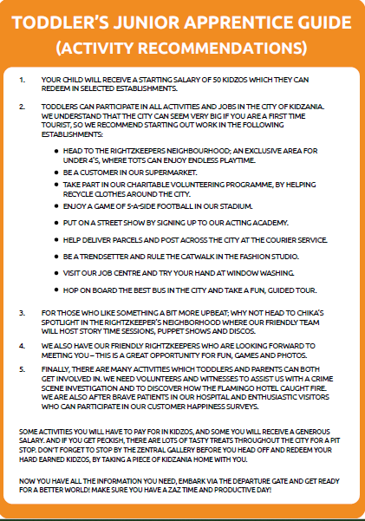
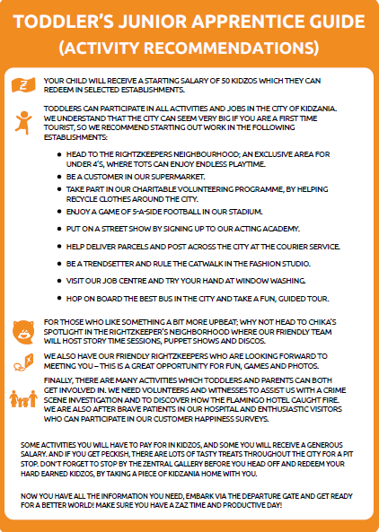

Slide 9
Materials

Slide 10
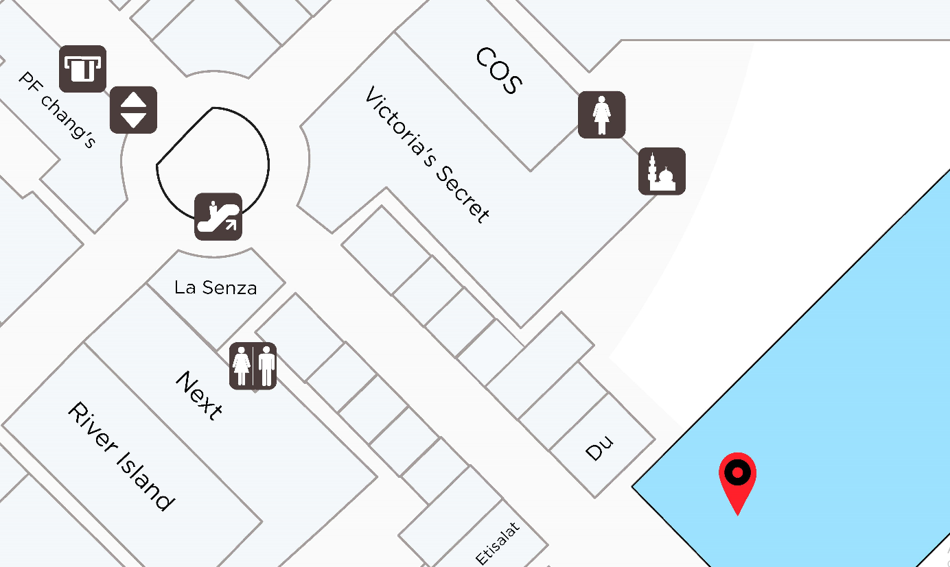
KidZania, Level G, Yas Mall
Bus Directions: Follow signs for Grand Prix Parking, after the traffic lights, keep right of the fork (avoiding any ramps) and head towards Debenhams car park and follow signs down ramp to lower ground floor, KidZania bus entrance.
10
The Business
10

Slide 11
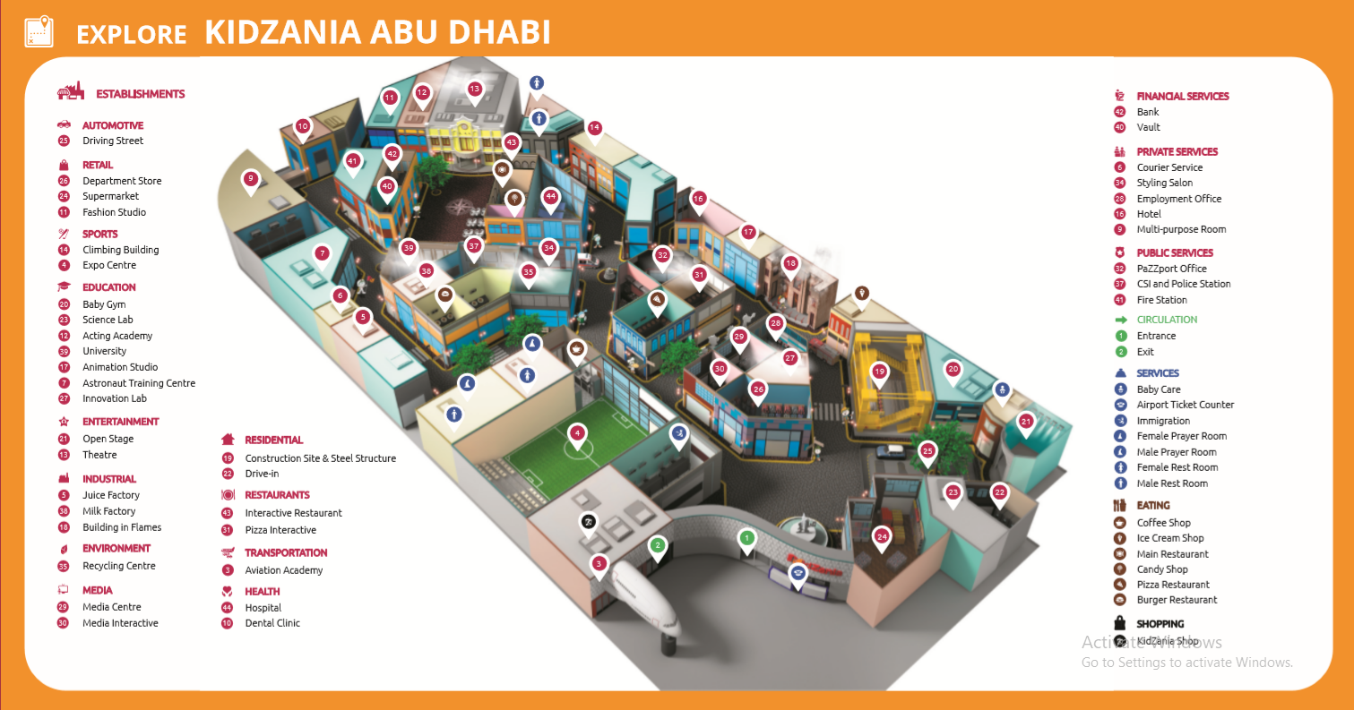
11
The Business
11

Slide 12
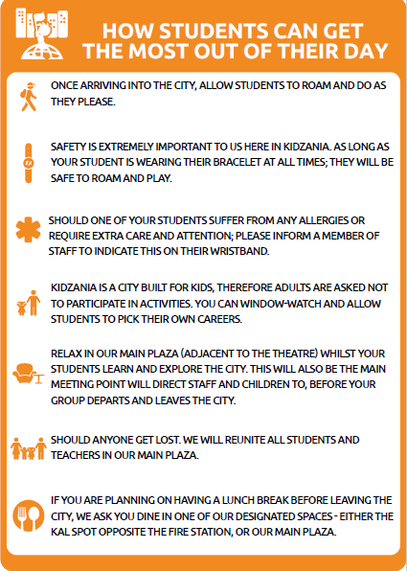
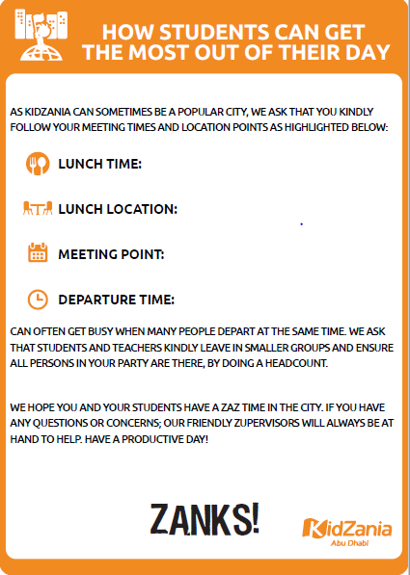
12
The Business
12

Slide 13

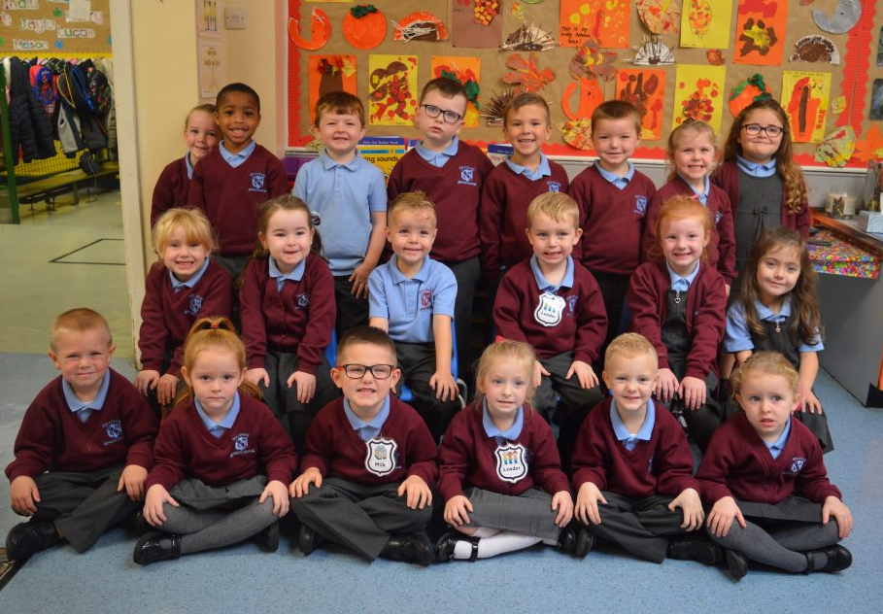
*upon request in advance

Slide 14

14
The Business
14

Slide 15
Frequently Asked Questions

Slide 16
Frequently Asked Questions
What is KidZania?
KidZania is an interactive kid-sized city combining fun and learning through exciting role-play guided activities for children aged 2-16 years.
KidZania was first introduced in Santa Fe, Mexico in 1999 and was created and developed by Mexican entrepreneur Xavier López Ancona, the Founder and CEO of KidZania. KidZania currently has 28 facilities in 21 cities around the world, including KidZania Abu Dhabi.
How does this kid-sized play city work?
KidZania is a kid-sized city where kids can explore over 70 role-playing activities in establishments found in a real city – such as a Fire Station, Hospital, Theater, Factories, TV Studio, and even an Airport! It is the ultimate role-playing environment where kids can safely discover how a city works and try out various professions. Each establishment offers a unique experience where they will learn financial literacy as they earn kidZos; KidZania’s own currency, which they can save in a bank account or use to purchase goods or services.
What do you mean by role-play?
Role-play comes naturally to kids. It is a kind of play that has continued across generations. Role-play develops problem solving and life skills as well as helps instill values. KidZania Abu Dhabi takes role-playing to the next level by building a city just for kids – providing a realistic and interactive environment for children play out numerous roles of their own choice. From police officer to performer to pearl hunter, KidZania Abu Dhabi currently offers over 70 role-playing activities with a range of difficulty to meet the abilities and interests of every child. Pilots navigate airplanes, television anchors read the news, police officers perform detective work and chefs cook up tasty food! When kids work, they earn kidZos, KidZania's own currency, so they can pay for goods and services in the KidZania city. Getting started is simple: kids pick an occupation, learn about their job, wear a uniform, start earning and spending kidZos, and have fun! Each activity lasts approximately 15 – 20 minutes.
16
The Business
16

Slide 17
Frequently Asked Questions
What are the activities offered in KidZania Abu Dhabi?
Every time a kid participates in an activity, he or she is taking on a role in that activity’s story. He is the heroic fireman who must rush to an emergency. She is the brilliant surgeon who treats an ailing patient or a lovely model who ramps on a catwalk.
Through their role-play experience in the different establishments, kids learn valuable information about the establishment – its purpose, roles, products and services, processes, and even trade advice. Activities in the establishments offer learning opportunities for kids to develop and practice important life skills.
The role-play activities in KidZania Abu Dhabi are designed to reinforce 21st century skills, complementing the K-12 program's vision for children.
What will KidZania Abu Dhabi benefit my students?
KidZania Abu Dhabi’s activity content will complement the curriculum of our international school system, enabling teachers to integrate visits with their lessons meaningfully.
The role-playing environment of KidZania Abu Dhabi will help children learn about how a city is structured and organized as well as explore what professions they might pursue further on in life. This environment will also help them learn valuable life skills such as financial literacy, social interaction, and responsibility for the environment.
KidZania was created for children to experience safe autonomy, the ability to make decisions, solve problems, and to learn within contexts and conditions.
17
The Business
17

Slide 18
Frequently Asked Questions
Where is KidZania Abu Dhabi located? Is this an indoor location?
KidZania is located inside Yas Mall, situated within the prestigious Yas Island.
Inside Yas Mall, KidZania is situated on ground level (Grand Prix, Mezzanine parking).
What are your operating hours?
KidZania Abu Dhabi is open 7 days a week.
Saturday - Wednesday
10:00 - 20:00
Admission counter closed 19:00
Thursday - Friday
10:00 – 22:00
Admission counter closed 21:00
18
The Business
18

Slide 19
Frequently Asked Questions
Is there an age limit?
KidZania Abu Dhabi's role-play activities are open to kids 2 to 16 years old. The activities have been designed to be developmentally appropriate for that age range.
Kids at least 120 cm tall will be allowed to explore the play city without parental or guardian supervision but each child's security bracelet must still be matched with an adult's security bracelet upon entry.
Kids below four (4) years old have dedicated establishment to toddler play and at the RightZKeepers' Residence. A parent can join the toddler play.
Are teachers allowed to accompany their students inside KidZania Abu Dhabi?
Teachers or school guardians must accompany the students during field trips to KidZania Abu Dhabi.
They can observe students as they participate in various role-playing activities.
There will be a set number of teachers per group of students.
Can teachers participate in activities?
KidZania Abu Dhabi empowers kids to explore independently and learn experientially so the role-playing activities are only for children. However, a teacher can assist any student who may be physically challenged as the child participates in the chosen activity.
For Field trip, are teachers exempt from paying entrance fees?
Yes, there will be an appropriate allotment of waived entrance fees for teachers or school guardians
per school group visiting KidZania Abu Dhabi.
For inquiries on field trips, send us an email schools@emaar.ae
19
The Business
19

Slide 20
Frequently Asked Questions
How long can we stay in KidZania Abu Dhabi?
Each ticket gives the visitor all day access to the play city.
Most activities inside KidZania Abu Dhabi and Abu Dhabi last from 15-25 minutes.
Can I leave KidZania before the group leaves their appointed time?
Yes, as long as there is another teacher or guardian that will be responsible for the students.
KidZania’s security requires the responsible school teacher or guardian to remain with the group
for the entire duration of the visit for the students’ safety and convenience.
We are considering KidZania Abu Dhabi and Abu Dhabi for our School Trip. Can we arrange a free ocular visit to check out KidZania Abu Dhabi or Abu Dhabi?
Yes, of course! You can contact our Ministry of Tourism and arrange a schedule
for you and/or your tour operators.
Please contact us on +971 50 557 2830 / +971 4 4485257 or email schools@emaar.ae
For Field trip, are teachers exempt from paying entrance fees?
Yes, there will be an appropriate allotment of waived entrance fees for teachers or school guardians
per school group visiting KidZania Abu Dhabi and Abu Dhabi.
For inquiries on field trips, send us an email schools@emaar.ae
20
The Business
20

Slide 21
Risk Assessment

Slide 22
Risk Assessment
Indoor Operation
  Everyday activity; No weather conditions
  Located The Abu Dhabi Mall (KidZania Abu Dhabi); Yas Mall (KidZania Abu Dhabi)
  Easy Access from Parking Area
Facilities
  Washroom
  Prayer room
  Elevator
  Telephone
  Restaurant
  Lounge
Service Intensive
  Zupervisor – all industries
  Team Leaders, Coordinators
  Duty Manager
  Security Marshals
Security system
  RFID Bracelet
  Surveillance Camera covering the whole city
  Security Marshals at every entry and exit points
  Equipped with Health ad Safety Equipment
  Health and Safety
    Resident Health and Safety Representative
    All Establishments are scaled down to children’s size
    Well trained professionals in case of emergency
22
The Business
22

